Slide 1

General Meeting
6 PM Tuesday, January, 2018⁹
Broun Hall, Room 235
Welcome to:

Slide 2

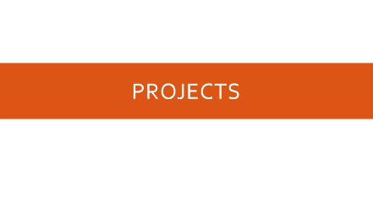
Agenda

Slide 3
About SPARC

Slide 4
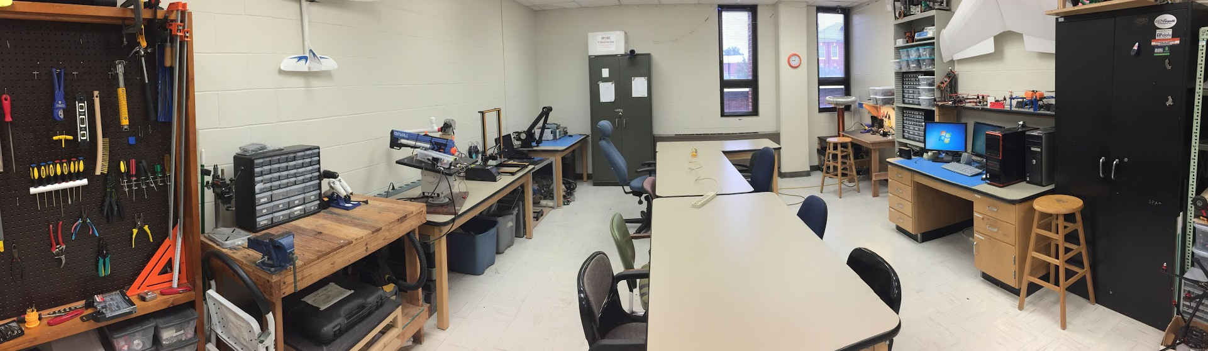
Creates and fosters an environment of creativity and innovation through collaborative projects.
A place to test out ideas, integrate concepts learned in class, and learn skills that will be instrumental when working in the workforce.
No prior experience is required, only a willingness to learn.
Join by logging 5 constructive hours in the lab on clipboard next to door and email sparc.auburn@gmail.com.
About SPARC
Lab:
- Broun 367
General Meetings:
- Tuesdays @ 6 in Broun 235
Project Meetings:
- Various Times during week

Slide 5


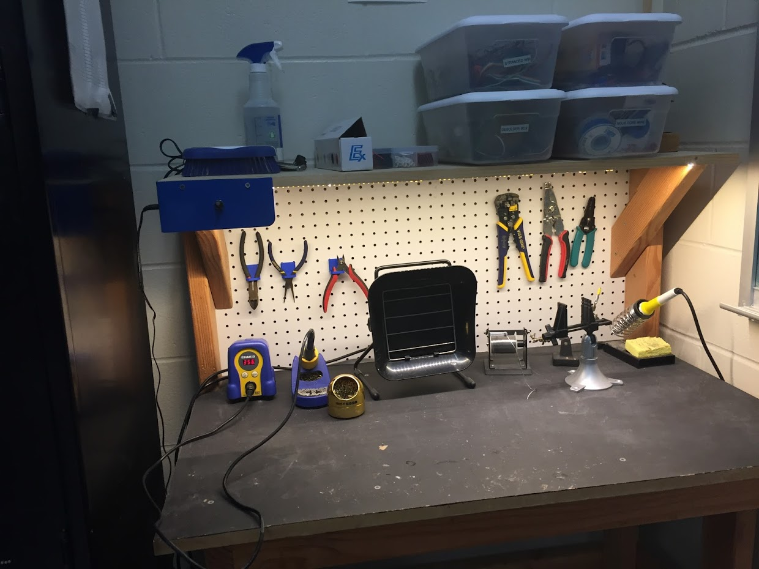
Our Lab
Broun Hall
Room 367

Slide 6
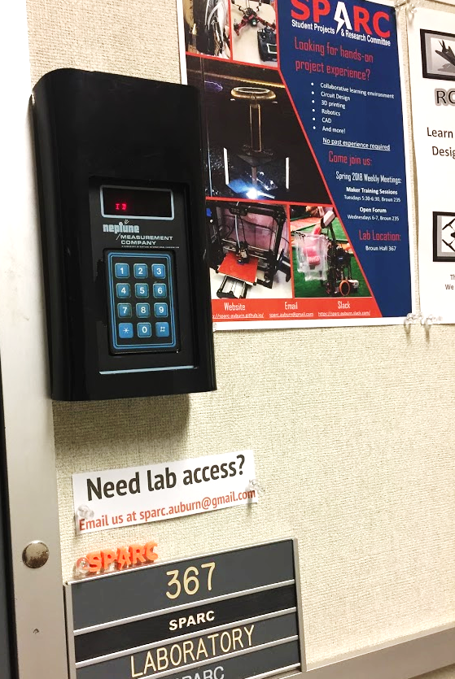
How to become a Member
Log 5 constructive hours in the lab
Write the times on the sheet on the clipboard next to the door.
Contact us at sparc.auburn@gmail.com
We will respond with the instructions to get an access code.

Slide 7




Website
http://sparc.eng.auburn.edu/
Github
https://github.com/SPARC-Auburn
Slack
https://sparc-auburn.slack.com/
Email
sparc.auburn@gmail.com
More Information about SPARC

Slide 8
Meetings this Week
Matilda Base - 4pm to 5pm - Thursdays
THAD – 1pm to 2pm - Tuesdays
MatildArm - 3pm to 4pm - Mondays
Tesla Coil - 11am to 12pm - Thursdays

Slide 9
Projects

Slide 10
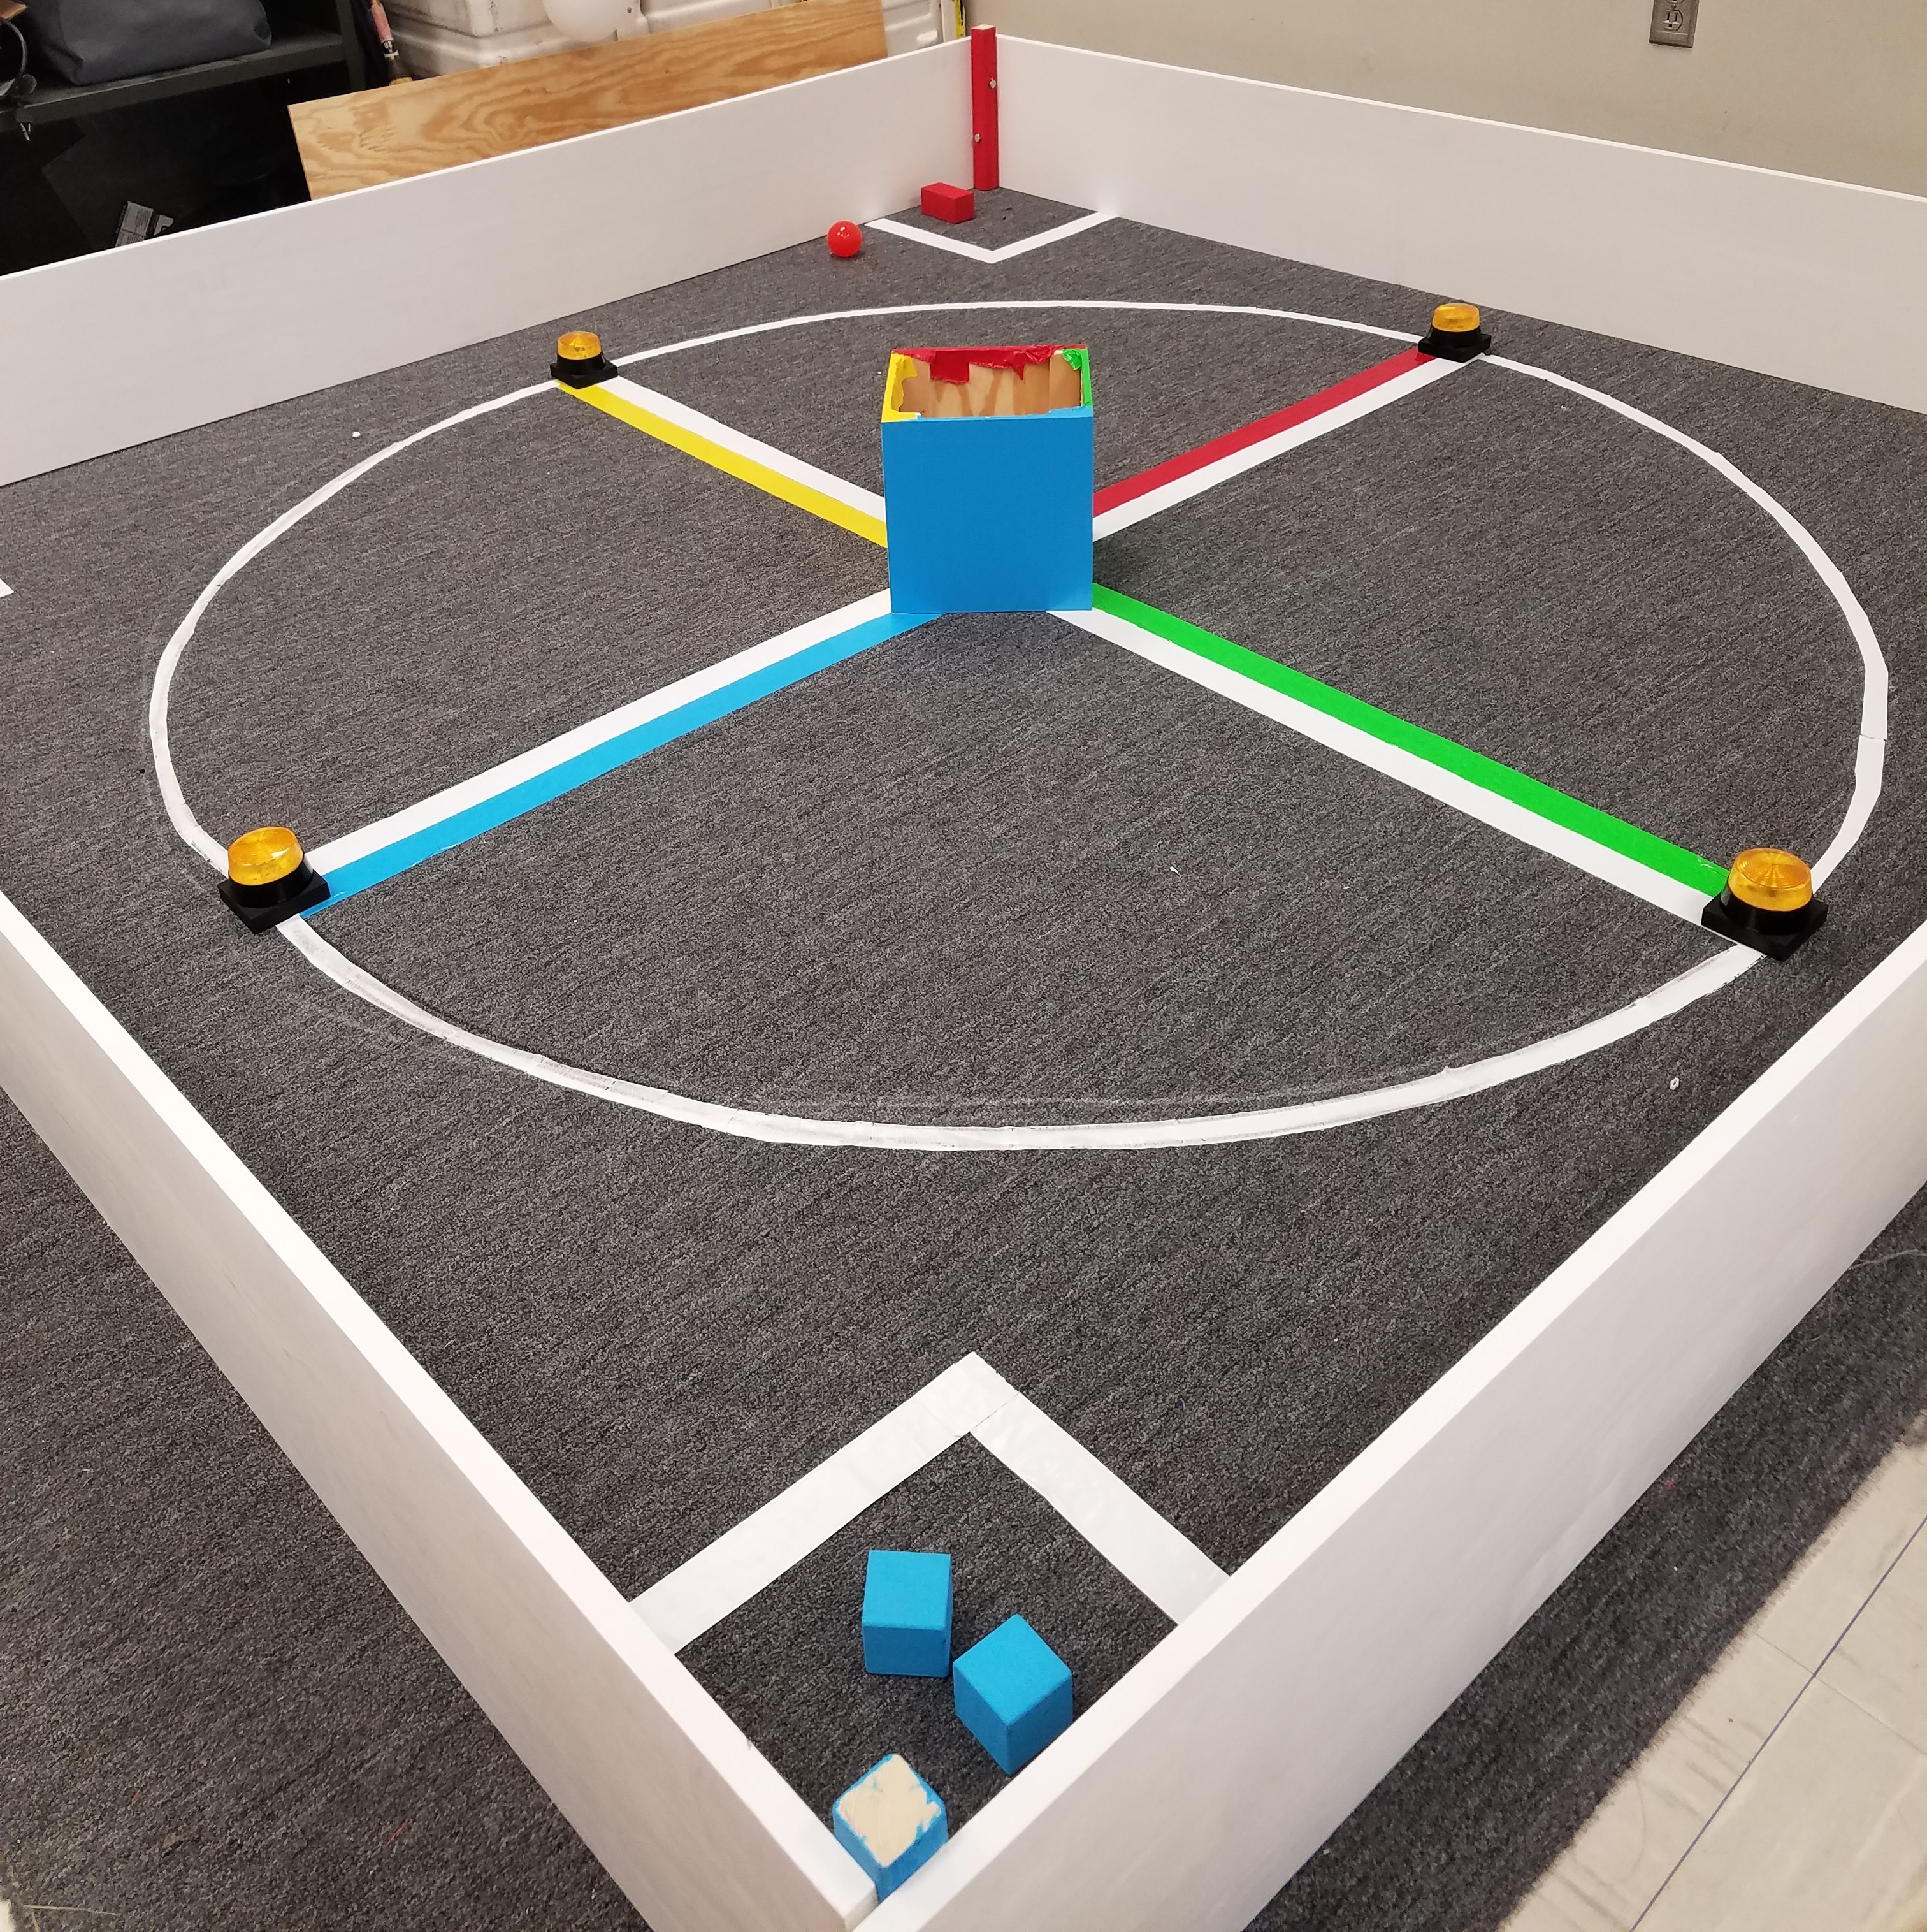
MAJOR PROJECT: IEEE SOUTHEAST CON
Project lead: Matthew Castleberry
Electrical lead: Josh Jablonowski
Mechanical lead: Alex Jones
Slack Channel: #projectieeeelectrical
Slack Channel: #projectieeemechanical
Competition Details:
Build a “space debris” collecting robot
Goal is to collect wood blocks and ball pit balls and deposit them on the side of a small flat ~100” square arena autonomously.
Max dimensions: 9” x 9” x 11”
When and Where:
Thursday, April 11th, 2019 through Sunday, April 14th, 2019.
IEEE Southeastcon conference in Huntsville, AL
Meeting Times
Electrical/Software Meeting: TBD
Mechanical Meeting: TBD
Programming Languages: C++,C
Gitlab: ask team lead for access

Slide 11
Status Updates
Mechanical
Recently Completed
3D design
Selection of motors
Parts ordered
Prototype assembled
In Progress
Selection/prototyping of wheel tread
Next Steps
3D model electrical mounts
Selection of motor battery
Selection of encoder
Electrical
Recently Completed
arena construction
auxiliary power
2D Vision processing
LIDAR data capture of field
Arduino motor control
Added Senior Design
In Progress
Debris distance detection
Basic System Integration
LIDAR data interpretation
Next Steps
Tune basic system

Slide 12
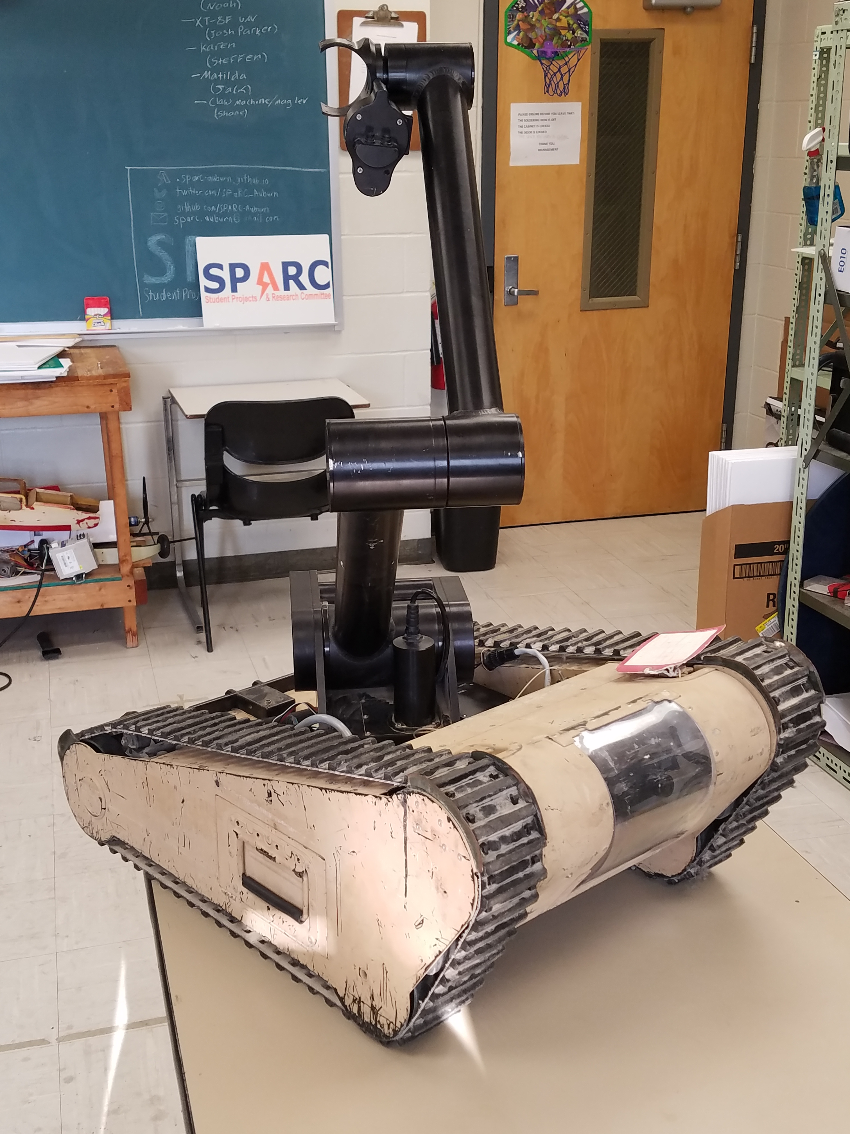
Project: MATILDArm
Project lead: Rice Shelley
Slack Channel: #projectmatildarm
MATILDA stands for Mesa Associates' Tactical Integrated Light-Force Deployment Assembly
A bomb disposal robot from Dr. Roppel’s research lab.
Arm is functional and controllable via Arduino.
Semester Focus
Reestablishing mobility and developing autonomy.
Ultimate goal is playing chess
Currently working on sensor functionallity. Primarily encoders

Slide 13
Project: MATILDa BASE
Project lead: TBD
Slack Channel: #projectmatildarm
MATILDA stands for Mesa Associates' Tactical Integrated Light-Force Deployment Assembly
A bomb disposal robot from Dr. Roppel’s research lab.
Base is functional and controllable via serial control.
Fancy RGB LEDs
Semester Focus
Add turret of some kind

Slide 14
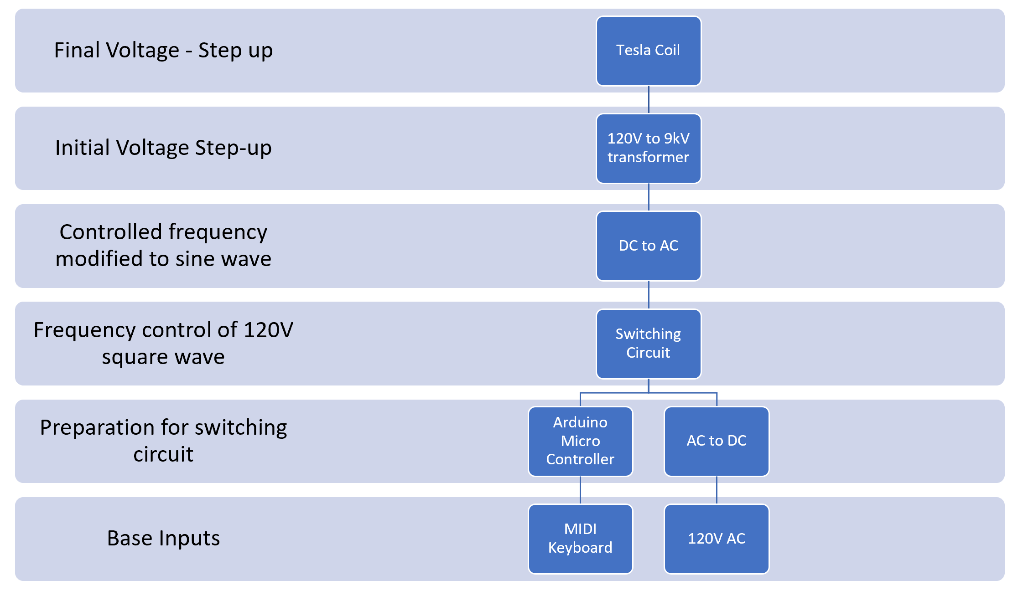
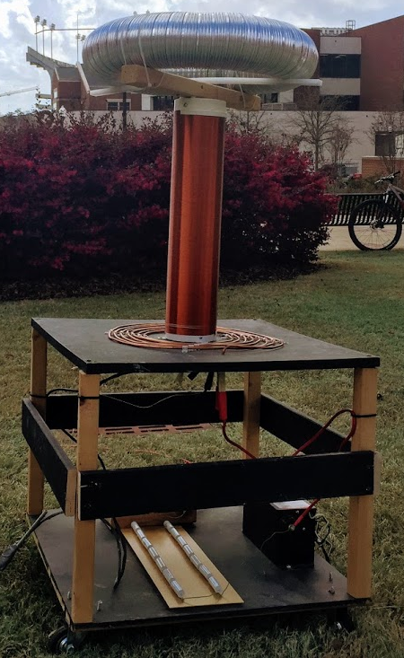
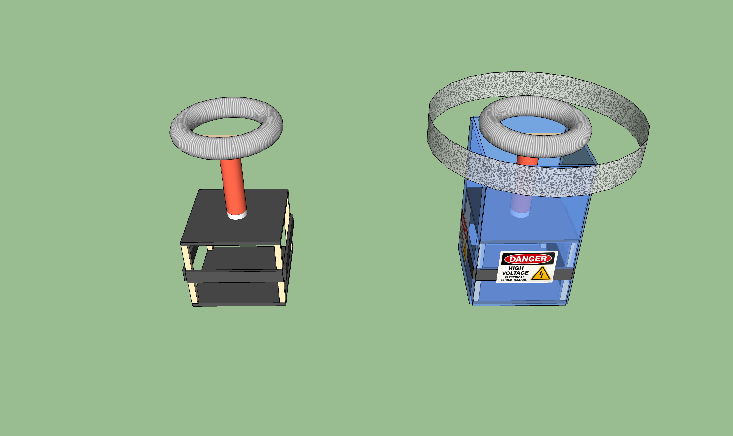
SIDE PROJECT #1: MUSICAL TESLA COIL
Project lead: Neil Postal
Slack Channel: #projectteslacoil
Demonstrated Tesla Coil at Spring 2016/18 E-Days
Currently uses spark gap style circuitry
Generated estimated 400,000 volts of electricity.
Semester Focus:
Increase safety precautions
Change from spark-gap design to solid-state design
Develop MIDI-input to allow music
Meeting times: Tuesdays & Thursdays @ 11:00

Slide 15
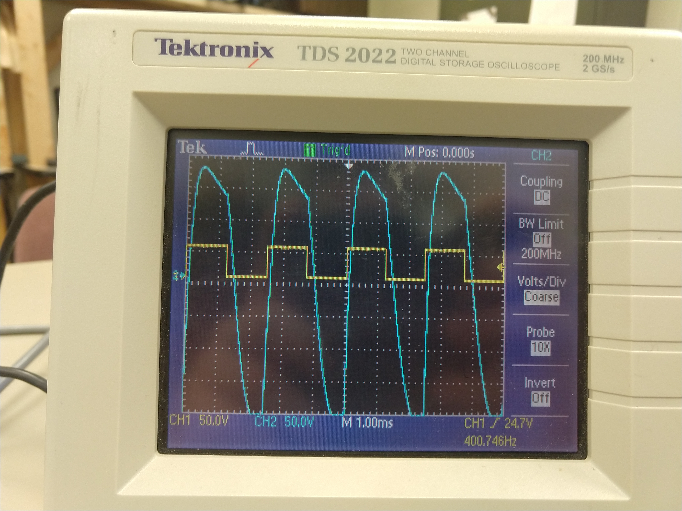
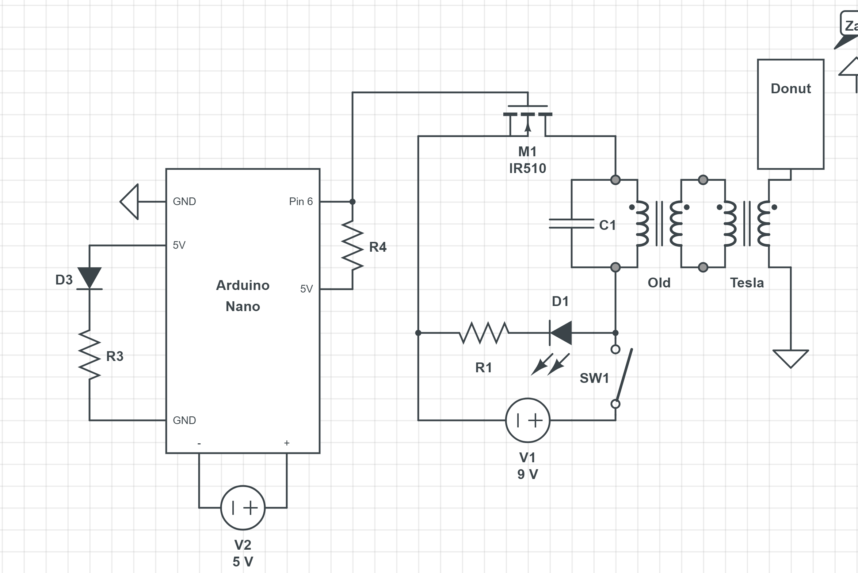
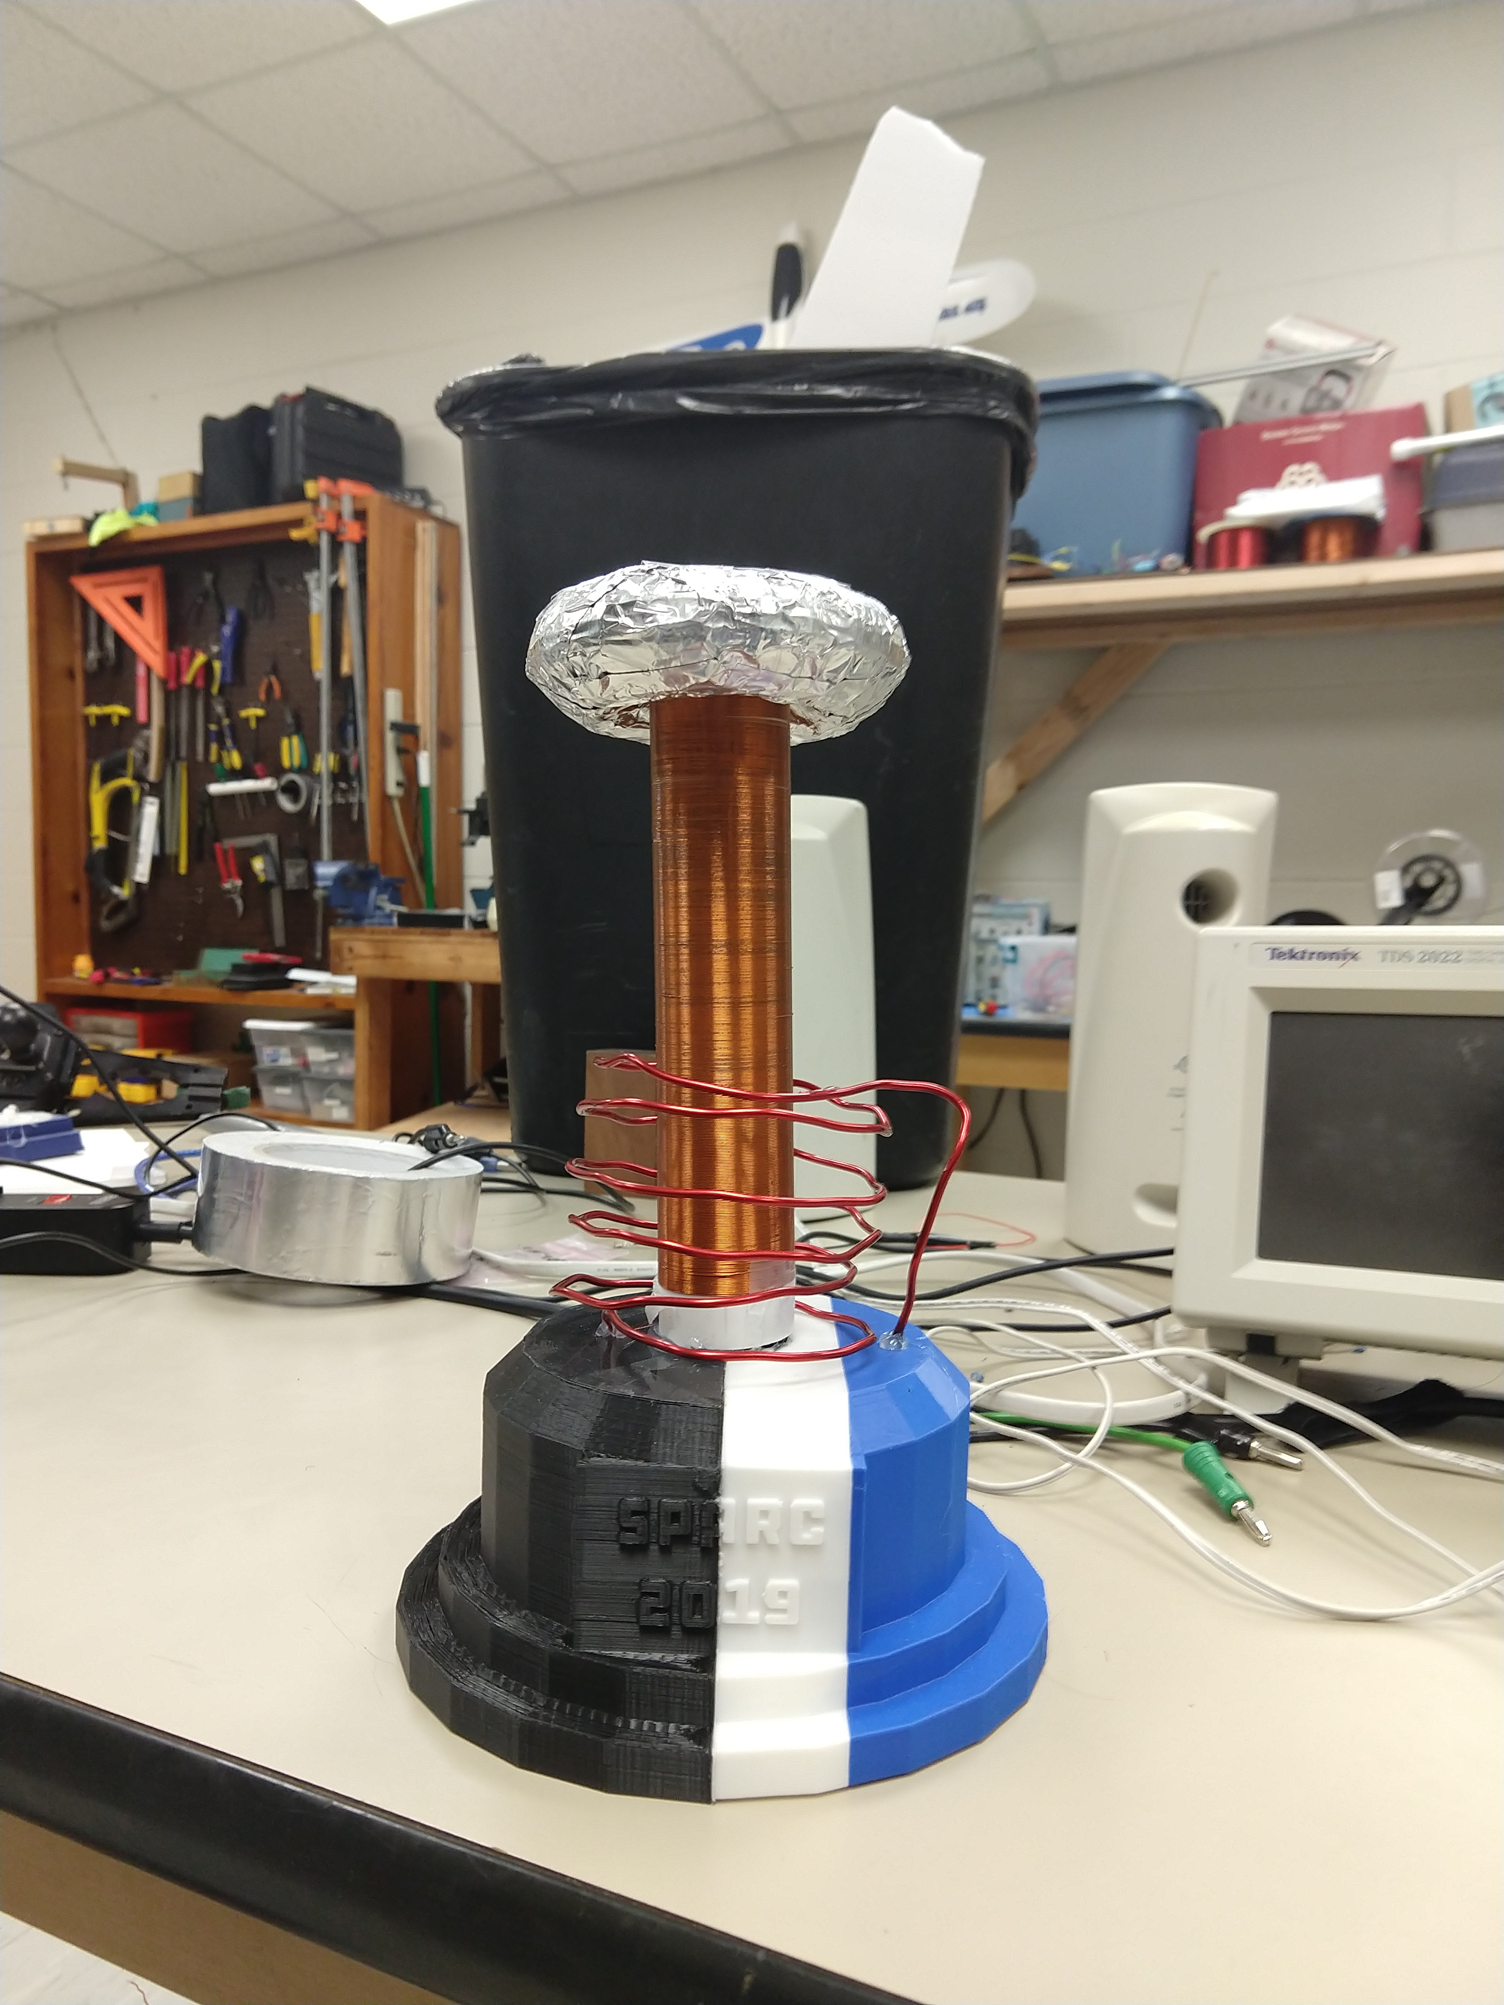
SIDE PROJECT #1: MUSICAL TESLA COIL
Project lead: Neil Postal
Slack Channel: #projectteslacoil
9V Computer-Controlled Square wave
Transformed to 600V AC wave

Slide 16
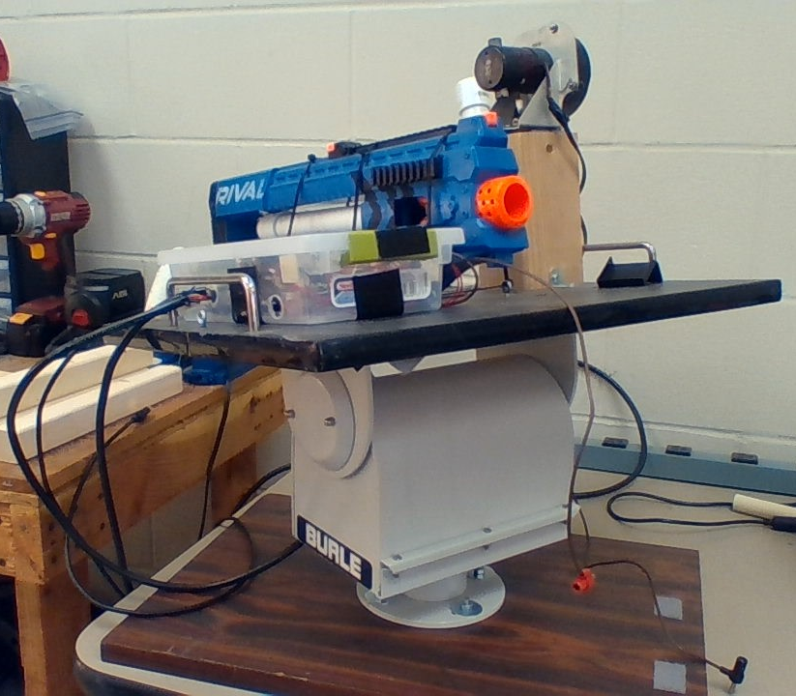
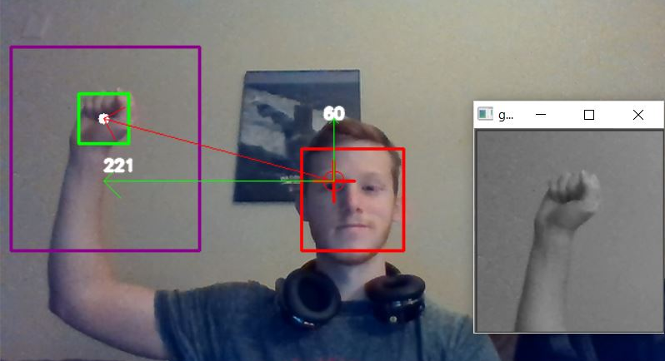
SIDE PROJECT: The Helpful Automated Defender
Project lead: Josh Jablonowski
Slack Channel: #projectthad
Old project donated by EE department
It was demonstrated last spring at E-Day and PEAK.
Needs a new purpose to improve demonstrations
Github Repository:
https://github.com/SPARC-Auburn/THAD
Programming Languages
Python w/ OpenCV
C

Slide 17
Questions?

Slide 18
Matilda Base

